Slide 1


Time to relook at the
Anti-defection law
Maj. Gen. Anil Verma (Retd.), Head – Association for Democratic Reforms
Ms. Shelly Mahajan, Senior Program Associate – ADR

Slide 2


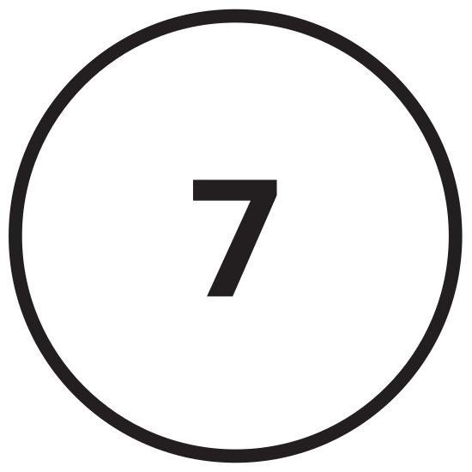




PREVIEW
Data on Defections
Defections over the Years
International Scenario
Anti-Defection Law
Anti-Defection: A non-issue
for voters
8
Recommendations
Costs of Defections
Suggested reforms & SC judgments
Notes:
Format of the PPT; source of data

Slide 3
“…however bad a Constitution may be, it may turn out to be good if those who are called to work it, happen to be a good lot. The working of a Constitution does not depend wholly upon the nature of the Constitution. The Constitution can provide only the organs of State such as the Legislature, the Executive and the Judiciary. The factors on which the working of those organs of the State depend are the people and the political parties they will set up as their instruments to carry out their wishes and their politics.”
- B.R. AMBEDKAR

Slide 4
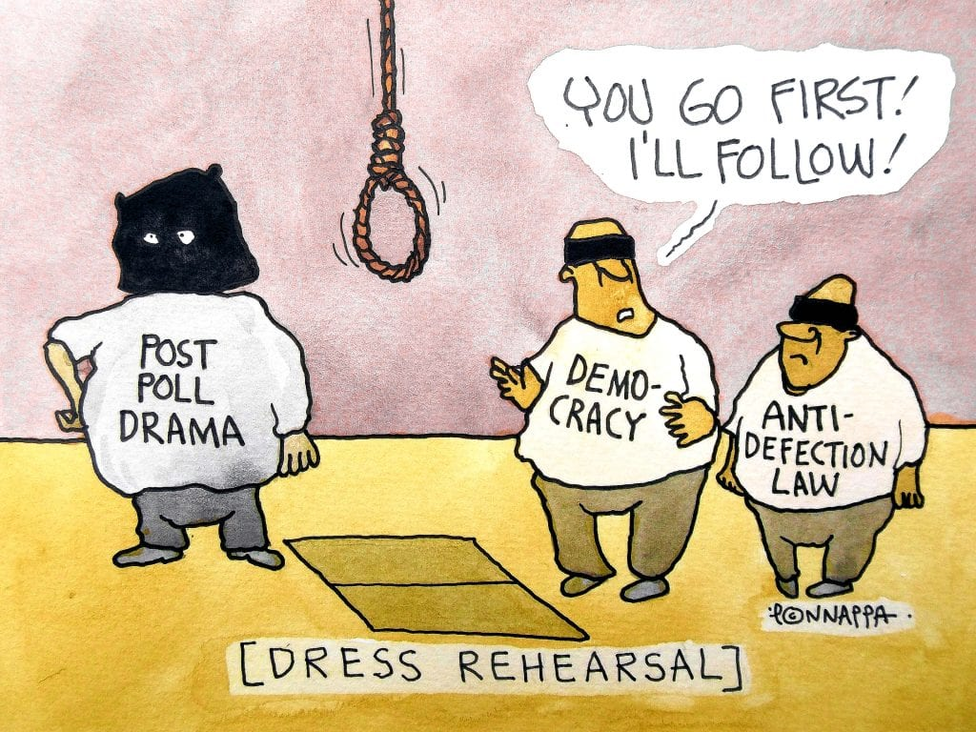

Slide 5
Association for Democratic Reforms (ADR), a citizen-led, non-political and non-governmental organization which has been around for more than 20 years now. Our goal is to improve governance and strengthen democracy by continuous work in the area of Electoral and Political Reforms.
  My Neta website (www.myneta.info) is an open data depository platform run by ADR which aims to empower Indian voters with the following information:
  Criminal, Financial and Educational information of candidates who have contested elections to State Assemblies, the Parliament and a few local bodies
  Details of Donations & Income-Expenditure statements of political parties

Slide 6
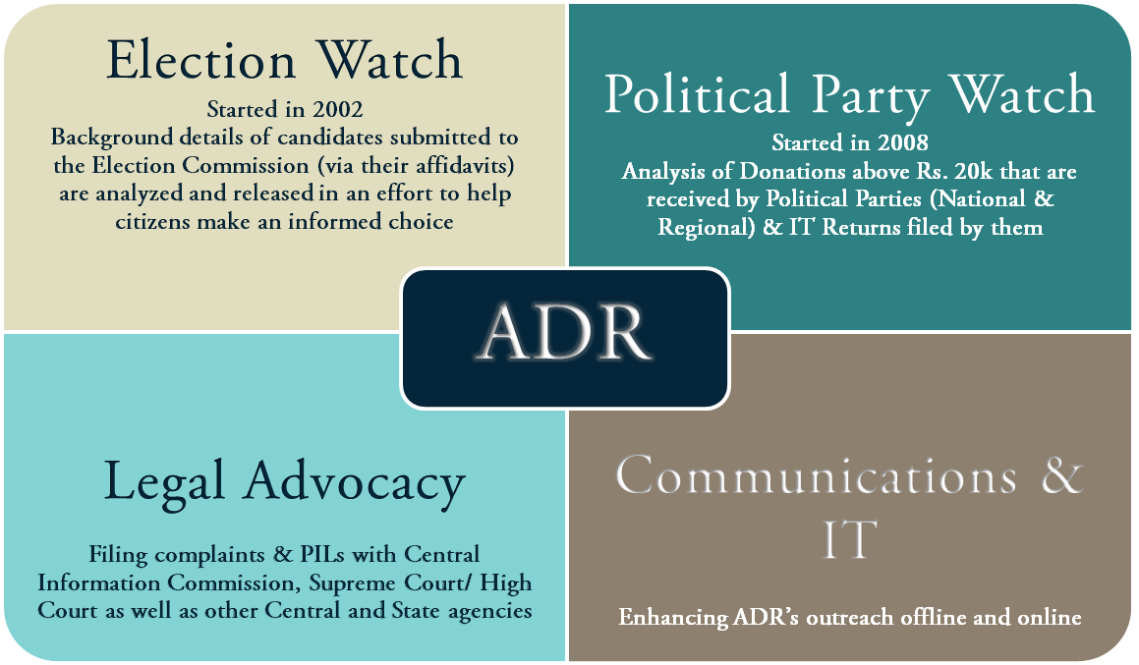

Slide 7
DATA ON DEFECTIONS
The decade between 1957-67 saw 542 members of Parliament and members of legislative parties switch political allegiances before the four-year period from 1967-71 spiralled the defection graph to unprecedented levels.
According to PRS Legislative Research, a Delhi-based non-profit organisation aimed at improving legislative processes, in those four years, 142 defections were reported in Parliament, while 1,969 MLAs crossed over to other parties in state assemblies across the country.
Thirty-two governments collapsed and 212 defectors were rewarded with ministerial positions, according to the agency.
Forty-five per cent of lawmakers who quit their parent political parties between 2016-2020 joined the BJP, according to a study conducted by the Association for Democratic Reforms (ADR). The Congress was the main loser in this period. Forty-two per cent of the total number of defecting legislators were elected on a Congress ticket.

Slide 8
PARTY-WISE DATA ON MPs/MLAs who left their parties
2014-2021
Party | Number of MPs/MLAs who left the party
INC | 177
BJP | 33
TDP | 26
AITC | 26
NCP | 25
BSP | 20
SP | 18
Yuvajana Sramika Rythu Congress Party | 16
NPF | 14
JD(U) | 12
RJD | 11
JVM(P) | 11
Aam Aadmi Party | 11
INLD | 10

Slide 9
ABOUT ANTI-DEFECTION LAW
Defection may be defined as the practice of floor-crossing by a member of one political outfit to another (also, commonly referred as Horse Trading). For instance, in Lok Sabha, if MPs of Party A join Party B, they are said to have defected and thus will face the prevalent anti-defection proceedings.

Slide 10
Why was anti-defection law enacted?
Combat political defections fuelled by political corruption and bribery. A Committee formed under the chairmanship of the then Home Minister YB Chavan (1969) recommended that for defections that were fuelled by monetary gains or by the lure for political office, the defectors should not only be barred from office, but should also be barred from standing in future elections for a prescribed time period.
Others have argued that defections flout the voters’ mandate. When a member defects from the party, he betrays the fundamental trust based on which people elected him to power.
As per the 1985 Act, a 'defection' by one-third of the elected members of a political party was considered a 'merger'. But the 91st Constitutional Amendment Act, 2003, changed this and now at least two-thirds of the members of a party must be in Favour of a "merger" for it to have validity in the eyes of the law.

Slide 11
WHAT DOES ANTI-DEFECTION LAW SAY?
The anti-defection law deals with situations of defection in Parliament or state legislatures by: (i) members of a political party, (ii) independent members, and (iii) nominated members. In limited circumstances, the law allows legislators to change their party without incurring the risk of disqualification.
NEED FOR ANTI-DEFECTION LAW
ISSUES WITH ANTI-DEFECTION LAW
Political Stability
Ensuring loyalty of party members
Upholds the will of the people
Reduces corruption & facilitates democratic
realignment of parties
Restricts freedom of speech & expression of legislators
No liability for political parties
Problem with merger provision
Power to the presiding officer
Unable to curb instability
Expulsion does not attract disqualification

Slide 12
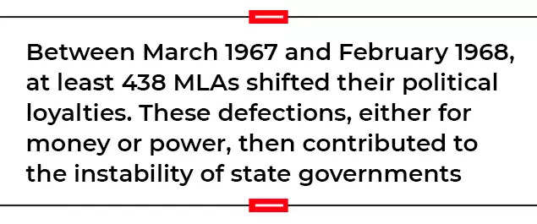
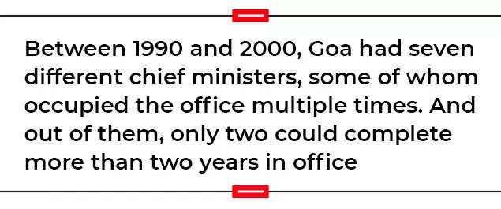
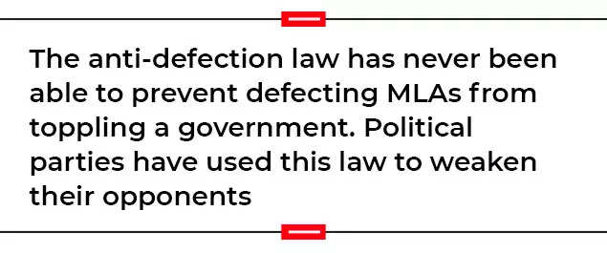
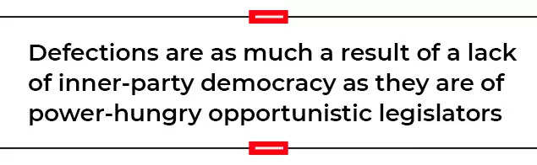
COSTS OF DEFECTIONs

Slide 13
POLITICAL FUNDING & DEFECTIONS
Notes:
it is seen that Electoral Bonds have emerged as the most popular mode of donations to National Political parties for FY 2019-20 as
well. More than 62% of the total income of seven National Parties came from Donations through Electoral Bonds (Rs 2993.826 cr)

Slide 14
Political funding & DEFECTIONS

Slide 15
DEFECTIONS OVER THE YEARS
Earlier, a weak Centre and a fragmented polity in states led to defections as politicians switched camps in order to form a majority government. The trend seems to have marked a curious reversal in the last eight years.
The presence of a mighty political party with a mammoth majority at the Centre and strong governments in a large number of states now ensure these splits and dethroning of elected governments.
Defections are no longer a symptom of fractured polity.
The Congress has seen the maximum and the most high-profile exits in recent years.
The Congress versus BJP battle perhaps reached its peak during the 2017 assembly elections in Uttarakhand. This election saw unprecedented defections and crossovers in all but 15-20 of the state’s 70 seats.
Two major factors that have seriously damaged the Indian polity are opportunistic alliances and political defections - both are interrelated and often appear together.

Slide 16
WHY IS ANTI-DEFECTION A NON-ISSUE FOR VOTERS?
Largely electorate chooses the party and not the candidate during elections else many defectors and candidates with questionable records would not have made it to the Parliament/Assemblies.
Voters seem to have accepted defection as a routine practice in Indian politics and do not consider as evil.
Lokniti-CSDS findings: 52% voters mentioned voting for the party while 37% voted for the candidate during 2019 LS elections. Party-centered voting neutralizes any displeasure that voters may have about their chosen representatives defecting and contesting again on a different party ticket.
Examples of defectors being re-elected on a party ticket against which they had contested the previous election. Ex: Congress party’s Himanta Biswa Sarma joined the BJP in 2015 and eventually became the Chief Minister in 2021. Manipur leader N Biren Singh joined the BJP due to differences with his Congress party and was later made the CM.
Voters do not express strong reservations against candidates with tainted backgrounds or those involved in corrupt practices. ADR National Survey 2018: 36.55% people vote for a criminal candidate because the candidate has spent generously in an election campaign whereas around 25% people vote for candidates facing criminal charges because they were of their own caste/religion.

Slide 17
Need for reforms
In 2020, the Supreme Court urged the Parliament to rethink the role of the Speaker or presiding officers of legislatures from taking decisions related to disqualification petitions.
According to former SC Justice PB Sawant, the 2003 remedy to the anti-defection law was “proving to be worse than the disease” and facilitated mass defections. He recommends further adjustments in the 10th Schedule to mandate defectors to resign their seats and face fresh elections.
SC also ruled that a period of three months was a “reasonable period” for a Speaker to dispose of disqualification petitions barring in “exceptional circumstances”.
“If a representative defies a party whip, the most the party must be allowed to do is remove the member from the party. Expulsion of the member from the House can only be the right of the House or the people,” Guruswamy wrote in the Deccan Chronicle this year.
The anti-defection law centralises power within political parties. The top leadership can dictate terms to all the party legislators. The lack of inner-party democracy in most Indian parties exacerbates the problem.
This law is a factor towards splintering of political parties as ambitious leaders facing internal barriers form their own parties.
Notes:
The move, experts suggest, would make the adjudication process in hearing disqualification petitions relatively more non-partisan, especially since the role of the presiding officers –who are affiliated to political parties– has often been accused of bias.
https://www.outlookindia.com/national/the-failure-of-india-anti-defection-laws-and-emergence-of-uneasy-coalitions-news-208175

Slide 18
SC judgments related to ANTI-DEFECTION LAW
In Kihoto Hollohan v. Zachilhu (1992) 1 SCC 309
The SC struck down Para 7 of the anti-defection law which provided the Speaker’s decision regarding the disqualification would be final and no court could examine its validity. Function of the speaker, while applying the Anti – defection law is like that of a Tribunal and therefore is open to judicial review.
In Rajendra Singh Rana v. Swami Prasad Maurya, AIR 2007 SC 1305
The Supreme Court held – when an application under 10th Schedule is made to the Speaker, he should decide it according to the procedure laid down under the rules. If the Speaker does not decide the matter, it is a clear misuse of his power and the court has power to review Speaker’s decision.
Notes:
Justice Verma in Hollohan judgment said that tenure of the Speaker is dependent on the continuous support of the majority in the House and therefore, he does not satisfy the requirement of such independent adjudicatory authority. Also, his choice as the sole arbiter in the matter violates an essential attribute of the basic feature. Thus, the need for an independent authority to deal with the cases of defection.

Slide 19
INTERNATIONAL SCENARIO
Among the Commonwealth countries, anti-defection law is prevalent in 23 nations.
In the UK Parliament, a member is free to cross over to the other side, without being daunted by any disqualification law. Whips are often issued by political parties in the UK. If an individual MP or MLA defies the whip, they continue to retain their membership of the legislature (although the party may take disciplinary action against them).
In the US, Canada, and Australia, there is no restraint on legislators switching sides.
Parties may issue directions or exert pressure if a member goes against the party line. However, legislators are not disqualified for defying the directives of their party.
Among the 40 countries that have an anti-defection law, only six countries have a law that mandates legislators to vote according to party diktat. The remaining countries only disqualify legislators if they are found to resign from their party or be expelled from it. Six countries that disqualify legislators who defy the party whip are India, Pakistan, Bangladesh, Guyana, Sierra Leone and Zimbabwe.

Slide 20
INTERNATIONAL SCENARIO
The anti-defection law in Bangladesh, Kenya, South Africa, and Singapore disqualifies a legislator on his ceasing to be member of the party or when he is expelled.
Bangladesh:
Article 70 of the Bangladesh Constitution says a member shall vacate his seat if he resigns from or votes against the directions given by his party.
The dispute is referred by the Speaker to the Election Commission.
Kenya:
Section 40 of the Kenyan Constitution states that a member who resigns from his party has to vacate his seat.
The decision is by the Speaker, and the member may appeal to the High Court.
Singapore:
Article 46 of the Singapore Constitution says a member must vacate his seat if he resigns, or is expelled from his party.
Article 48 states that Parliament decides on any question relating to the disqualification of a member.
South Africa:
Section 47 of the South African Constitution provides that a member loses membership of the Parliament if he ceases to be a member of the party that nominated him.

Slide 21
RECOMMENDATIONs
Political parties should limit issuance of whips to instances only when the government is in danger.
The words ‘voluntarily giving up membership of a political party’ should be comprehensively defined.
The term political party should be defined clearly.
The Speaker must rule on a dispute under the Tenth Schedule as expeditiously as possible. For this, a period of six months for disposal of the petition has been recommended.
Disqualification should be limited to cases where (a) a member voluntarily gives up the membership of his political party, (b) a member abstains from voting, or votes contrary to the party whip in a motion of vote of confidence or motion of no-confidence.
Restrictions like prohibition on joining another party or holding offices in the government should be imposed on expelled members.
Defectors should be barred from holding public office or any remunerative political post for the duration of the remaining term of the legislature.
The vote cast by a defector to topple a government should be treated as invalid.

Slide 22
RECOMMENDATIONs
Dinesh Goswami Committee (1998), Commission to Review the Constitution (2002), Law Commission (2015) and The 170th Report of the Law Commission: Defection cases must be decided by the President or Governor for centre and states respectively, who shall act on the advice of the Election Commission.
Former secretary-general of the Lok Sabha, PDT Achary said “The right to vote should freeze as soon as an MLA or MP decides to defect,” he said.
The anti-defection law could be the biggest hurdle in conducting simultaneous elections in India, according to a ‘working draft’ report prepared by the Law Commission of India. “The only recourse to overcome this is to do away with the rigours of the anti-defection law. An exception must be carved out so that a member asking for support from the members of other political parties to form the government is able to secure the same,” the report states.
In Keisham Meghachandra Singh vs The Honble Speaker Manipur, 2020:
Three-judge Bench led by Justice Rohinton F. Nariman; Parliament may seriously consider amending the Constitution to substitute the Speaker of the Lok Sabha and Legislative Assemblies as arbiter of disputes concerning disqualification which arise under the Tenth Schedule with a permanent Tribunal headed by a retired Supreme Court Judge or a retired Chief Justice of a High Court, or some other outside independent mechanism to ensure that such disputes are decided both swiftly and impartially.

Slide 23
RECOMMENDATIONs
The way to address defections has to be a political one, and not a legal one. Political parties are broad coalitions of people with similar ideologies. They need to attract and retain members through their ideological positions.
They also need to build internal processes for members to rise to the top positions — as long as a party is dominated by a family, an ambitious non-family person has no choice but to exit the party.
This law strikes at the core of Indian democracy. The government has legitimacy because it is accountable to MPs. In turn, MPs are accountable to the people who elected them. However, due to this law, MPs (especially of the party in government) can no longer question its actions. Holds true for MLAs as well.
The solution for defections is not to strengthen the anti-defection law but to scrap it.
Voters’ education and awareness about the consequences of defections for governance is required.

Slide 24
THANK YOU

